Slide 1
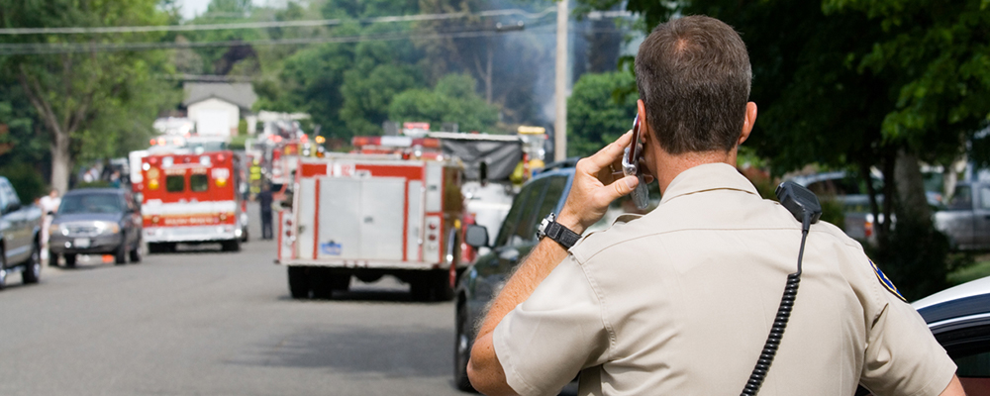
The Benefits and Challenges of Video Calling for Emergency Situations
Carman Neustaedter, Brennan Jones, Kenton O'Hara, Abigail Sellen Paper
84734 Fábio Alves 84831 Sérgio Aguiar
04/04/2019
Notes:
April 21–26, 2018
Pags: 14

Slide 2
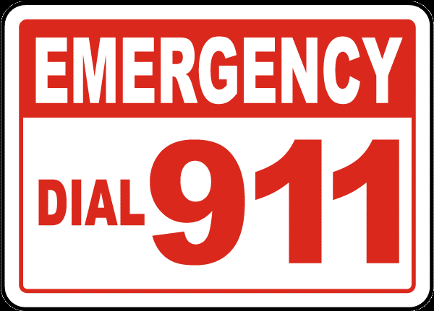

Choice
Important for the future
Improve existing services

Slide 3
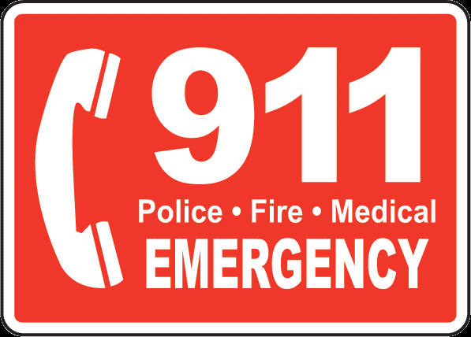

Introduction
Since the late 1960s, in North exist means to ask for emergency assistance.
Telephone is the main communication for emergency situations and 9-1-1 services.
Canada is trying to create the ‘Next Generation 9-1-1’.
This paper focus in explore various aspects of video calling for 9-1-1 calls.
Make an introduction and contextualization of the problem

Slide 4
Objectives
In what ways might video calls enhance 9-1-1 services and when might they inhibit them?
How should video calling technologies be designed such that they meet the needs of the caller, call taker, and dispatcher to ensure emergency calls are efficient and effective?
What effects might there be on the work practices of 9-1-1 call takers if video calls are introduced?

Slide 5
Benefits/Challenges
Benefits:
- Acquire information from those who cannot easily speak.
- Additional contextual information of scenes;
- Overcome information inaccuracies;
Challenges:
- Stress;
- Issues around control;
- Information overload;
- Privacy issues.

Slide 6
Study methodology
CALL CENTRE 1:
- Large rural area with a collection of small cities and towns;
- Around 130 000 people;
- Typically 2 call takers/dispatchers on at a time.
CALL CENTRE 2:
- Medium sized city;
- Around 100 000 people;
- Typically 2 call takers/dispatchers on at a time.
CALL CENTRE 3:
- Metropolitan city;
- Around 1.4 Million people;
- Typically around 60-80 staff working at a time.

Slide 7


Method
7 to 10 hours at each call centre to observe work practices
Listening in on calls
In sitru interviews

Slide 8

Method
Two main topics of discussion:
Challenges faced in different call types
Thoughts on the usage of video for emergency calls

Slide 9


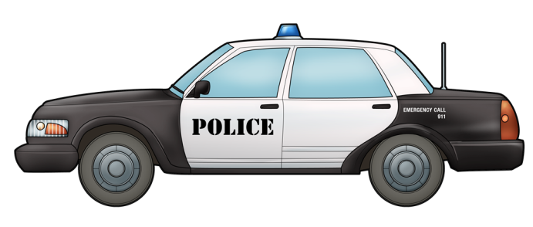
Contextual Information of a Situation
What does the caller need?
Name?
Phone Number?
Location?

Slide 10
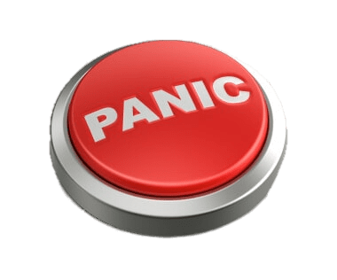

Caller Uncertainty or Inability to Describe a Situation
Callers are often in a state of panic
Callers might be injured

Slide 11
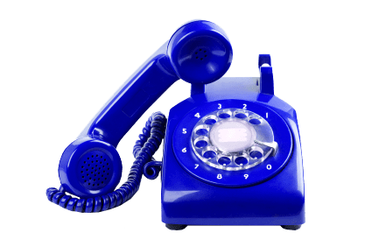
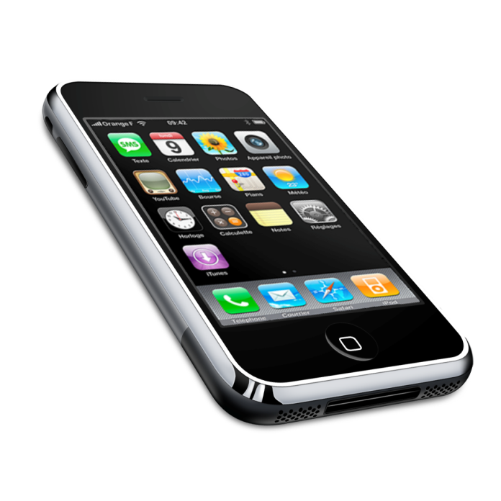
Location Information
Accurate location
Inaccurate between several meters and half a kilometer

Slide 12


Information Inaccuracies
Not every caller states the truth
Domestic Abuse cases are the most evident ones

Slide 13
Challenges with Emergency Video Calling

Slide 14


Controlling the Call
Involves a sequence of questions
Requires specific camera work

Slide 15



Liability and Training
What they saw
What they were told

Slide 16



Distraction and Information Overload
Where to watch the video?
5 computer screens in constant use
Lack of desire to change what each was showing

Slide 17


Seeing Challenging Scenes
Could cause Stress
Could trigger a permanent PTSD

Slide 18



Video Views of Call Takers
Two-way streams are undesirable
Anonymity was deemed very important

Slide 19

Conclusion
This work could set up a rich research agenda.
Caller insight is also important, so this suggests future studies aimed at a broad spectrum of callers.
There is also much work to be done on exploring the design of video calling solutions and testing out the ideas that may stem from more research.

